Slide 1
Lecture 8
Topics: Thinking in Objects, Part I
Chapter 10, Sections 10.1 – 10.8

Slide 2
Class Abstraction and Encapsulation
Class abstraction: The separation of class implementation from the use of a class.
Class encapsulation: The details of implementation are encapsulated and hidden from the user.
The creator of a class describes the functions of the class and lets the user (i.e. developer) know how the class can be used.
Class contract: The collection of fields and methods that are accessible from outside the class, in addition to the description of how these members should behave.
The user does not need to know all the details of the implementation – just needs to be able to use it.
Notes:
Abstraction: For example, a programmer writing code that involves numerical operations may not be interested in the way numbers are represented in the underlying hardware (e.g. whether they're 16 bit or 32 bit integers), and where those details have been suppressed it can be said that they were abstracted away, leaving simply numbers with which the programmer can work.

Slide 3
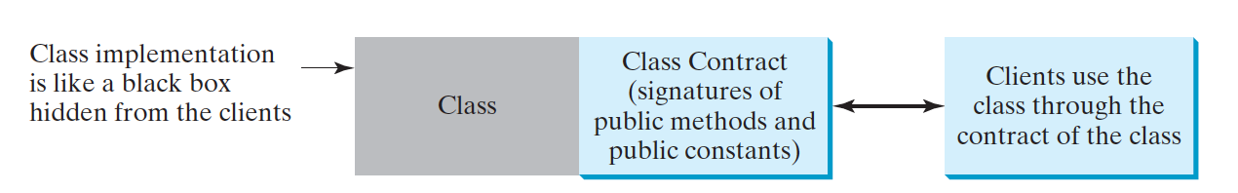
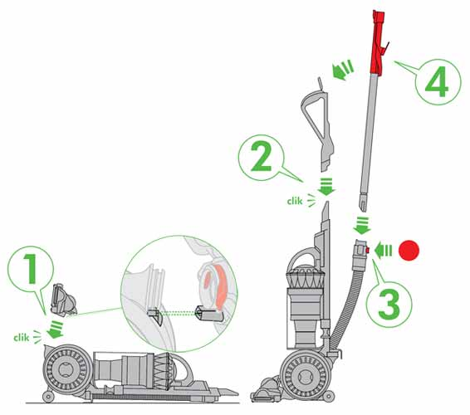
Notes:
Class abstraction can be viewed as assembling a new vacuum cleaner.
Your vacuum arrives with pieces and an instruction for assembling the pieces.
You don’t necessarily need to know how each piece works internally (like the motor), but if you follow the instructions (class contract), then you can assemble it (object).

Slide 4
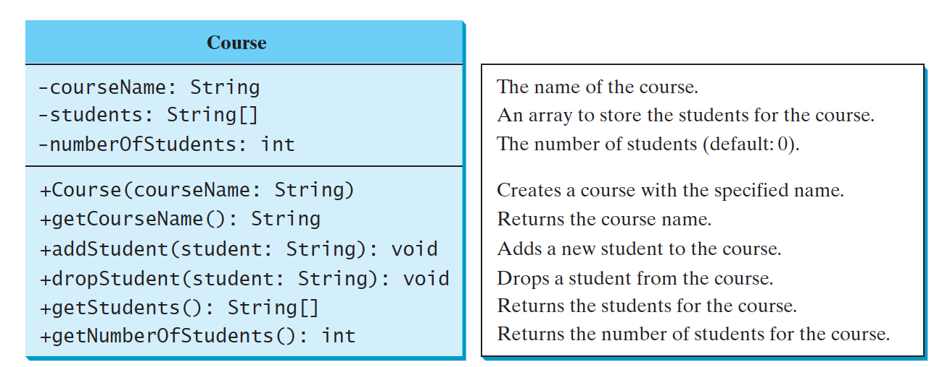
Example
Students is an array of names (Strings).
What if we wanted more information about each student in the array? Like their ID number or email address?
Should we add student ID number and email address to the Course?? Where does that information belong?

Slide 5

Class Relationships
To design classes, you need to explore the relationships among classes.
Relationship types: Association, aggregation, composition and inheritance (inheritance will be talked about in a couple of weeks).

Slide 6
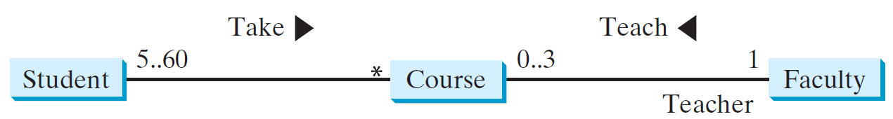
Association
Binary relationship that describes an activity between two classes.
An association is illustrated by a solid line between two classes with an optional label that describes the relationship.
Each relationship may have an optional small black triangle that indicates the direction of the relationship.
Each class involved in a relationship may specify a multiplicity, which is placed at the side of the class to specify how many of the class’ objects are involved in the relationship.
Notes:
* means unlimited
m..n indicates that the number of objects is between m and n inclusively

Slide 7
Translating Association to Code
public class Student
{
private Course[] courseList;
public void addCourse(Course c)
{
. . .
}
}
public class Course
{
private Student[] students;
private Faculty faculty;
public void addStudent(Student s)
{
. . .
}
public void setFaculty(Faculty f)
{
. . .
}
}
public class Faculty
{
private Course[] courseList;
public void addCourse(Course c)
{
. . .
}
}
"Student takes a course."
"Faculty has courses."
"Course has students."
"Course has one faculty."

Slide 8
Aggregation and Composition
Forms of association.
Aggregation: Represents an ownership relationship between two objects. It’s called a “has-a” relationship.
Owner object is called an aggregating object and its class the aggregating class.
Subject object is called an aggregated object and its class the aggregated class.
Composition: An object can be owned by several other aggregating classes. If an object is exclusively owned by an aggregating object, then this is referred to as composition.

Slide 9


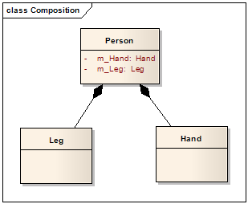
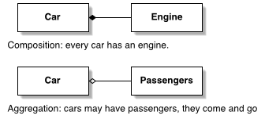
Examples
Notes:
Composition: filled in diamond
Aggregation: open diamond

Slide 10
Designing classes
We want to design a book class. What are the parts of a book?
Pages, words, sentences, etc.
A book has pages. Is this composition or aggregation?
Composition.
Book
Page
- pages: Page[]
- sentences: String[]
+ Book(p: Page[])
+ getPage(num: int) : Page
+ getPageCount() : int
+ Page(s: String[])
+ getSentence(num: int) : String
+ getSentenceCount() : int
Notes:
Composition because those pages belong to one specific book
We are not going to take them out and put them in a different book.

Slide 11
Which class do we create first?
Page
public class Page
{
private String[] sentences;
public Page(String[] s)
{
this.sentences = s;
}
public String getSentence(int num)
{
return this.sentences[num];
}
public int getSentenceCount()
{
return this.sentences.length;
}
}
- sentences: String[]
+ Page(s: String[])
+ getSentence(num: int) : String
+ getSentenceCount() : int

Slide 12
Book
- pages: Page[]
+ Book(p: Page[])
+ getPage(num: int) : Page
+ getPageCount() : int
public class Book
{
private Page[] pages;
public Book(Page[] p)
{
this.pages = p;
}
public Page getPage(int num)
{
return this.pages[num];
}
public int getPageCount()
{
return this.pages.length;
}
}
public class Page
{
private String[] sentences;
public Page(String[] s)
{
this.sentences = s;
}
public String getSentence(int num)
{
return this.sentences[num];
}
public int getSentenceCount()
{
return this.sentences.length;
}
}

Slide 13

Taking a quick detour to Wrappers
Sometimes you want to treat a primitive type like an object.
There is a wrapper class for every primitive type.
You can recognize wrapper classes because each one is named after the primitive type it wraps, but with the first letter capitalized to follow a naming convention.
For reasons absolutely nobody on the planet is certain of, the API designers decided not to map the names exactly from primitive type to class type.

Slide 14
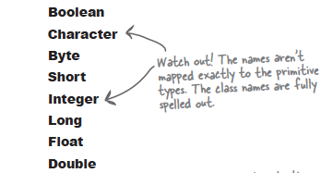
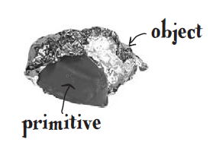
The Integer class has a constructor
that takes one argument!
Integer myIntObject = new Integer(42);
Give the primitive to the wrapper
constructor - that’s it!
Class name!

Slide 15
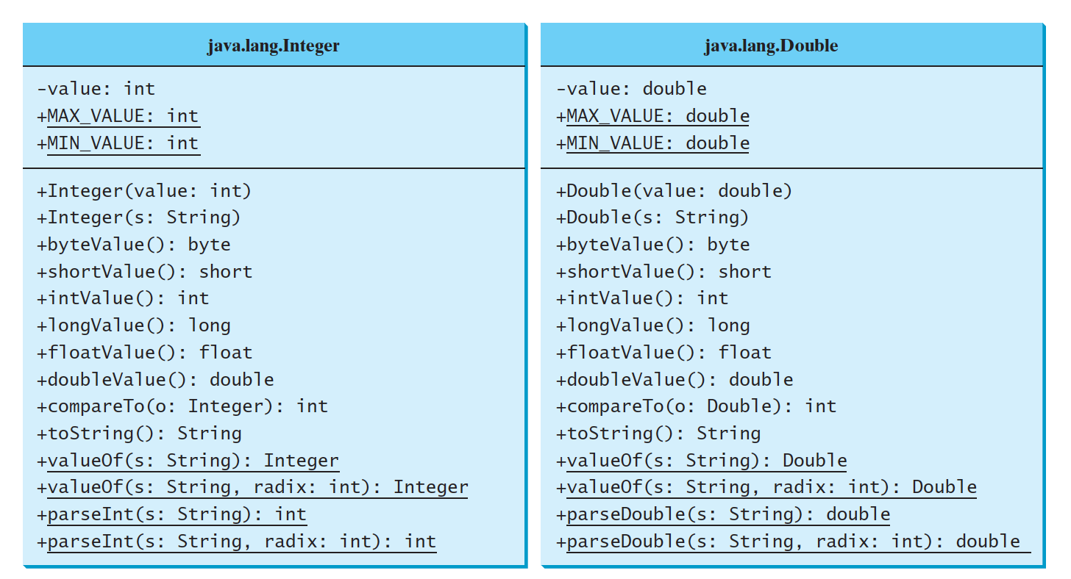
No longer available in Java 8!
The wrapper classes do not have no-arg constructors.
The wrapper classes are immutable. You cannot change the object once it has been created.
What are the static methods and variables in these classes?
Notes:
Each numeric wrapper class has the constants MAX_VALUE and MIN_VALUE which represents the maximum and minimum value of the corresponding data types.

Slide 16
The parseInt, parseDouble, etc. methods
Have you ever wished that you could just change a string into a number in order to do calculations?
The numeric wrapper classes contain a static method that converts a string to the corresponding primitive type.
parseByte, parseShort, parseInt, parseLong, parseFloat, parseDouble
If the string cannot be converted to the specified primitive type, a NumberFormatException occurs.
Notes:
NumberFormatException - if the string cannot be converted to the correct primitive type.

Slide 17
public static void main(String[] args)
{
double d1 = Double.parseDouble("12.3");
System.out.println(d1);
int i1 = Integer.parseInt("765");
System.out.println(i1);
double d2 = Double.parseDouble("87");
System.out.println(d2);
int i2 = Integer.parseInt("19.3");
System.out.println(i2);
}
12.3
765
87.0
Exception in thread "main" java.lang.NumberFormatException: For input string: "19.3"
at java.lang.NumberFormatException.forInputString(NumberFormatException.java:65)
at java.lang.Integer.parseInt(Integer.java:580)
at java.lang.Integer.parseInt(Integer.java:615)
at Test.main(Test.java:10)

Slide 18
The valueOf method
The numeric wrapper classes contain the static valueOf method for converting a string to a numeric object.
This method creates a new object initialized to the value represented by the specified string.
If the string cannot be converted to the specified numerical wrapper, a NumberFormatException occurs.

Slide 19
public static void main(String[] args)
{
Double d1 = Double.valueOf("12.3");
System.out.println(d1.doubleValue());
Integer i1 = Integer.valueOf("765");
System.out.println(i1.intValue());
Integer i2 = Integer.valueOf("19.3");
System.out.println(i2);
}
12.3
765
Exception in thread "main" java.lang.NumberFormatException: For input string: "19.3"
at java.lang.NumberFormatException.forInputString(NumberFormatException.java:65)
at java.lang.Integer.parseInt(Integer.java:580)
at java.lang.Integer.parseInt(Integer.java:615)
at Test.main(Test.java:8)

Slide 20
The compareTo method
The numeric wrapper classes contain the compareTo method for comparing two numbers.
This is because a "wrapped" primitive type is an object and you can't use == to determine equality.
Returns 1 (greater than), 0 (equal to), -1 (less than) when comparing the left side to the right side.

Slide 21
public static void main(String[] args)
{
Double d1 = Double.valueOf("12.3");
Double d2 = Double.valueOf("15.5");
Double d3 = Double.valueOf("-3.4");
Double d4 = Double.valueOf("15.5");
int c1 = d1.compareTo(d2);
System.out.println(c1);
int c2 = d2.compareTo(d1);
System.out.println(c2);
int c3 = d1.compareTo(d3);
System.out.println(c3);
int c4 = d4.compareTo(d2);
System.out.println(c4);
}
-1
1
1
0

Slide 22


Automatic Boxing and Unboxing
I’m in a box! Help!
The conversion from a primitive type to its corresponding wrapper class is called boxing.
Integer n = 4;
Java does it automatically for you - i.e. autoboxing.
The reverse conversion from an object of a wrapper class to its associate primitive type is called unboxing.
Integer n = new Integer(6);
int pn = n;
Java does it automatically for you - i.e. autounboxing.
I’m free!

Slide 23
BigInteger and BigDecimal
The BigInteger and BigDecimal classes can be used to represent integers or decimal numbers of any size and precision.
If you need to compute with very large integers or high-precision floating-point values, you can use the BigInteger and BigDecimal classes in the java.math package.
Both are immutable .

Slide 24

Example
public class Example
{
public static void main(String[] args)
{
System.out.println(factorial(5));
System.out.println(factorial(100));
}
public static int factorial(int n)
{
int f = 1;
for (int i = n; i > 0; i--)
f *= i;
return f;
}
}
Output
120
0

Slide 25
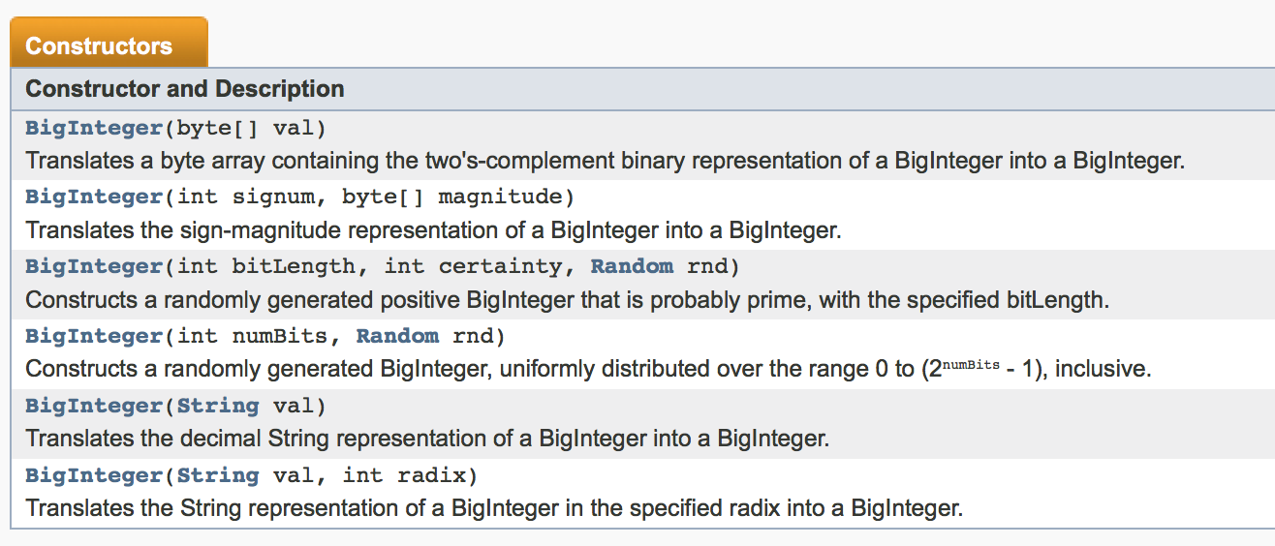
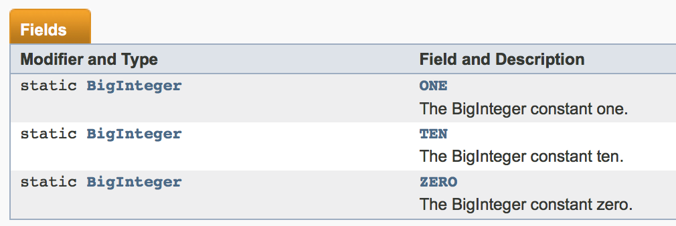

Slide 26
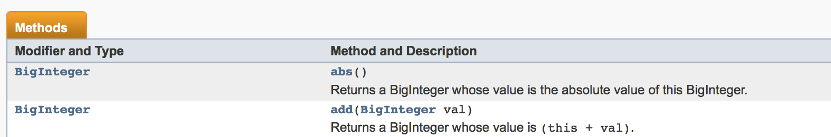
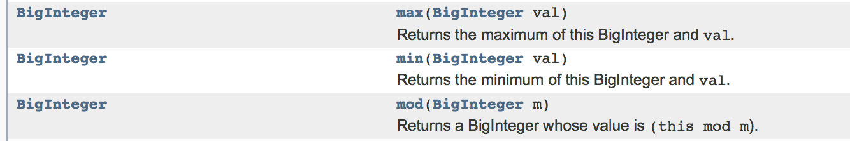
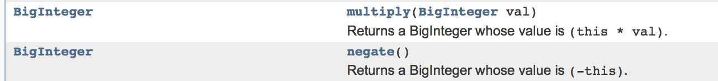

Slide 27
public class Example
{
public static void main(String[] args)
{
System.out.println(factorial(5));
System.out.println(factorial(100));
}
public static int factorial(int n)
{
int f = 1;
for (int i = n; i > 0; i--)
f *= i;
return f;
}
}
import java.math.*;
public class Example
{
public static void main(String[] args)
{
System.out.println(factorial(5));
System.out.println(factorial(100));
}
public static BigInteger factorial(int n)
{
BigInteger f = BigInteger.ONE;
for (int i = n; i > 0; i--)
f = f.multiply(new BigInteger(i + ""));
return f;
}
}
Output
120
93326215443944152681699238856266700490715968 26438162146859296389521759999322991560894146 39761565182862536979208272237582511852109168 64000000000000000000000000
Output
120
0

Slide 28
True or False?
True
A wrapper is used when you want to treat a primitive like an object.
There is no wrapper class for boolean primitives.
Static methods do not have access to instance variables.
False
True

Slide 29

That’s all for today!
Homework #5 is due Thursday, 02/25/16 by 9:00 a.m.

